Slide 1




“What is Adverse Information”?
Do you know the answer?

Slide 2


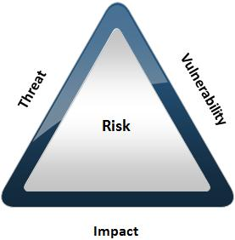
WHAT IS ADVERSE
The Government defines Adverse Information as “any information that adversely reflects on the integrity or character of a cleared employee, that suggests that his or her ability to safeguard classified information clearly may not be in the interest of national security”.

Slide 3
ADVERSE INFORMATION MAY BE…
Alcohol Abuse
Drug Involvement
Various types of criminal conduct including arrests
Employee allegiance to the United States
Reoccurring Security Violations
Serious financial difficulties, bankruptcy
Emotional mental and personality disorders that impede a cleared employee from properly safeguarding Classified

Slide 4


When in doubt about Adverse Information…contact Security
Dela Williams,
Facility Security Officer
(407) 882-1123 or dela.williams@ucf.edu

